Slide 1
長短期記憶神經網路(LSTM)應用 機器翻譯(Machine Translate)
06360656 黃崇睿
06360471 曾智群

Slide 2
主要功能介紹
英翻中
中翻英
厲害吧

Slide 3
主要程式碼
encoder_inputs = Input(shape=(None, num_encoder_tokens))
encoder = LSTM(latent_dim, return_state=True)
encoder_outputs, state_h, state_c = encoder(encoder_inputs)
encoder_states = [state_h, state_c]
decoder_inputs = Input(shape=(None, num_decoder_tokens))
decoder_lstm = LSTM(latent_dim, return_sequences=True, return_state=True)
decoder_outputs, _, _ = decoder_lstm(decoder_inputs,
initial_state=encoder_states)
decoder_dense = Dense(num_decoder_tokens, activation='softmax')
decoder_outputs = decoder_dense(decoder_outputs)
model = Model([encoder_inputs, decoder_inputs], decoder_outputs)
model.compile(optimizer='rmsprop', loss='categorical_crossentropy')
model.fit([encoder_input_data, decoder_input_data], decoder_target_data,
batch_size=batch_size,epochs=epochs,validation_split=0.2)
model.save('s2s.h5')
encoder_model = Model(encoder_inputs, encoder_states)

Slide 4
主要程式碼
decoder_state_input_h = Input(shape=(latent_dim,))
decoder_state_input_c = Input(shape=(latent_dim,))
decoder_states_inputs = [decoder_state_input_h, decoder_state_input_c]
decoder_outputs, state_h, state_c = decoder_lstm(
decoder_inputs, initial_state=decoder_states_inputs)
decoder_states = [state_h, state_c]
decoder_outputs = decoder_dense(decoder_outputs)
decoder_model = Model(
[decoder_inputs] + decoder_states_inputs,
[decoder_outputs] + decoder_states)

Slide 5
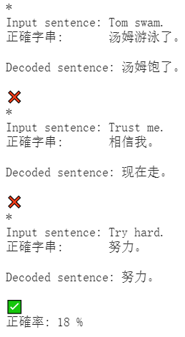
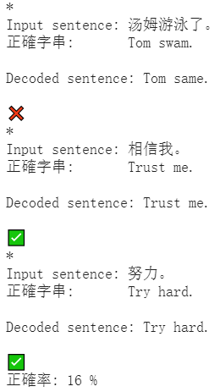
成果展示

Slide 6
謝謝大家

